Slide 1



CODF Transformation
September 9, 2004
Kickoff Meeting

Slide 2
Agenda
CODF Transformation Kick-off
9:30 – 11:00 Kickoff Meeting:
  Welcome & Introductions Martin
  Project Goals/Scope Marshall
  Project Organization Martin
  Proposed Architecture Solution John / Craig
  Planned Approach Martin
  Key Communications / Controls Martin
  Collaboration Tool Martin
  Logistics Martin
  Next Steps Martin
  Q & A
  Issue Arlington Park Tickets
11:15 – 12:30 Travel to Arlington Park (own means)
12:30 – 1:00 Meet in International Room
1:00 – 4:30 HAVE FUN!

Slide 3
Introductions
CODF Transformation Kick-off
Marshall Gibbs Business Owner/Champion
Ron Byczynski / Ed Horton Relationship Manager
John West Chief Technical Architect
Craig Chapa Senior Solution Architect
Ed McLaughlin IRI Technical Design Lead
Jeanne Livelsberger Business Architect
Claire Gourdain-Dwyer Requirements Manager
Sanjay Tamta Delivery Center Team Lead
Fred Grigg Grid Architect
Todd Barron Grid Project Management
Bob Reed Acxiom Project Management
Martin Wills Project Management Lead

Slide 4
Project Goals/Scope
CODF Transformation Kick-off
The scope for the development of the CODF encompasses the real-time processing, warehousing, analysis and delivery of insights and information from large amounts of POS, panel, audit and customer specific data.
The scope of the CODF Transformation project itself is from the time data is extracted from a data supplier until a custom data mart is delivered

Slide 5
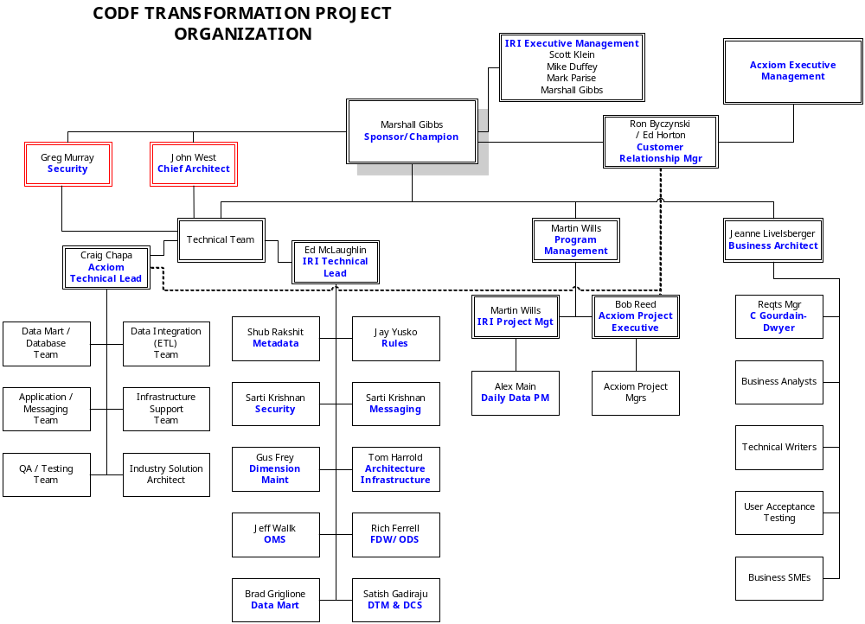
CODF Transformation Kick-off

Slide 6
Proposed Architecture Solution
CODF Transformation Kick-off
The architecture will combine elements of IRI, Acxiom and third party technologies.
The basic point of the architecture is to produce a large number of custom and syndicated data marts.
This will be done in a way that is both more automated and more cost efficient than current IRI systems.

Slide 7
Proposed Architecture Solution
CODF Transformation Kick-off
The architecture is broken up into several discrete components :
Data Transfer Manager: landing and processing data from our data partners - based initially on existing IRI capabilities
Data Scrubbing and Loading: managing the data quality process and loading the data into the central data warehouse - based on Ascential DataStage technology
Central Data Warehouse: holds both main fact databases, and various dimension and operational data stores - deployed in Oracle and uses Acxiom’s file processing grid to enable faster access to data

Slide 8
Proposed Architecture Solution
CODF Transformation Kick-off
Order Management System: eliminates the manual process used today to control client deliverables through the factory - a configuration based system to manage customer requirements against CODF deliverables
Rules Engine: handles business and process rules that control various factory components (e.g. quality control, releasability, etc.) - ILOG will be used for this purpose
Metadata Management System: captures application meta-data as well as audit and lineage data used for managing the data investigations process - based on MetaStage from Ascential and the Acxiom meta-data system

Slide 9
Proposed Architecture Solution
CODF Transformation Kick-off
Aggregation Engine: creating data marts in a fast, cost efficient and easy to configure manner - custom technology developed to leverage Ascential for handing the job runtime in the grid environment
Dimension Maintenance Subsystem: handles various IRI dimensions - based on upgraded version of existing IRI technologies and managed in an Oracle RDBMS
Grid implementation: handles both data mart construction and file data processing not housed in an RDBMS (includes extract caches for data mart construction and files coming in from our data partners) - will use Acxiom grid technologies

Slide 10
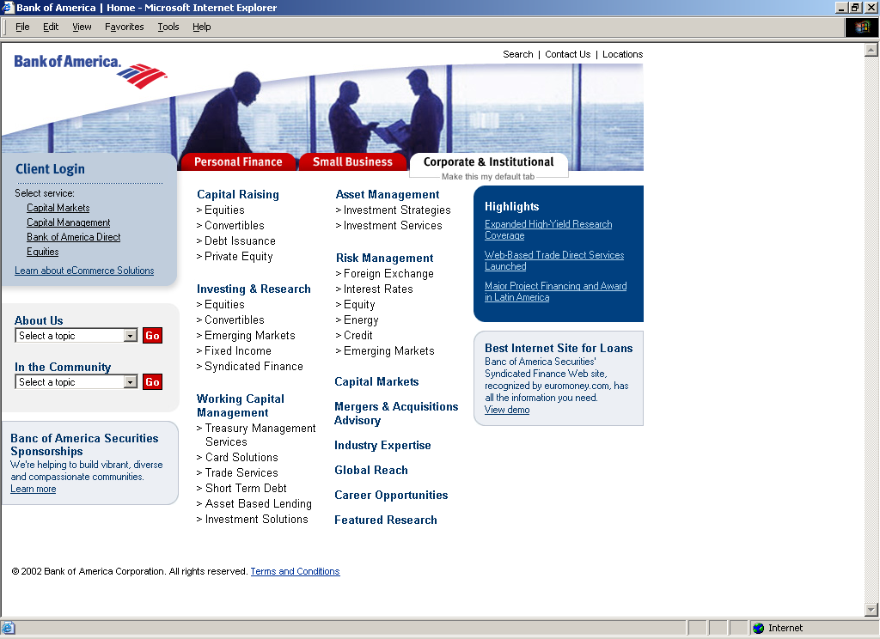
CODF Transformation Kick-off
Order
CODF Architecture - Logical
OMS
Messaging
CONFIGURATOR
CONFIGURATOR
D
a
t
a
M
a
r
t
s
VI-DI
SCHEDULING & OPTIMIZATION
SCHEDULING & OPTIMIZATION
DTM
DCS
Factory Data
Warehouse
FEE
IRI APPS
DTM
RULES
RULES
Processing Grid
Processing Grid
IRI Platform Grid
FILES
Data Files
Data Grid
Metadata
Operational
Order
Rules
Configuration
Acxiom
Other
IRI APPS
Operational Data Stores
Attributes
Orders
Dimensional
Measures
Audit
Instrumentation
Services

Slide 11
CODF Transformation Kick-off
CODF Architecture Software mapped to functional components
Order
OMS
Messaging
JMS
APIARY
APIARY
CONFIGURATOR (ILOG)
CONFIGURATOR (ILOG)
D
a
t
a
M
a
r
t
s
VI-DI
SCHEDULING & OPTIMIZATION
(NEXUS & ORBITOR)
SCHEDULING & OPTIMIZATION
(NEXUS & ORBITOR)
DCA
ASI
META
STAGE
DATA
STAGE
META
STAGE
DATA
STAGE
DTM
DCS
Factory Data
Warehouse
ORACLE
FEE
IRI APPS
DTM
ENIGMA
RULES (ILOG)
RULES (ILOG)
Data Lineage Custom Application
Data Lineage Custom Application
Processing Grid
Processing Grid
IRI Platform Grid
FILES
ACXIOM Data Grid File Manager (DGFM)
Data Files
Data Lineage Custom Application
Data Grid
Metadata METASTAGE
Operational
Order
Rules
Configuration
Acxiom
Other
IRI APPS
Operational Data Stores ORACLE
Attributes
Orders
Dimensional
Measures
Audit
Instrumentation
Services
J2EE & .NET Web Services
Java Beans & .NET Framework

Slide 12
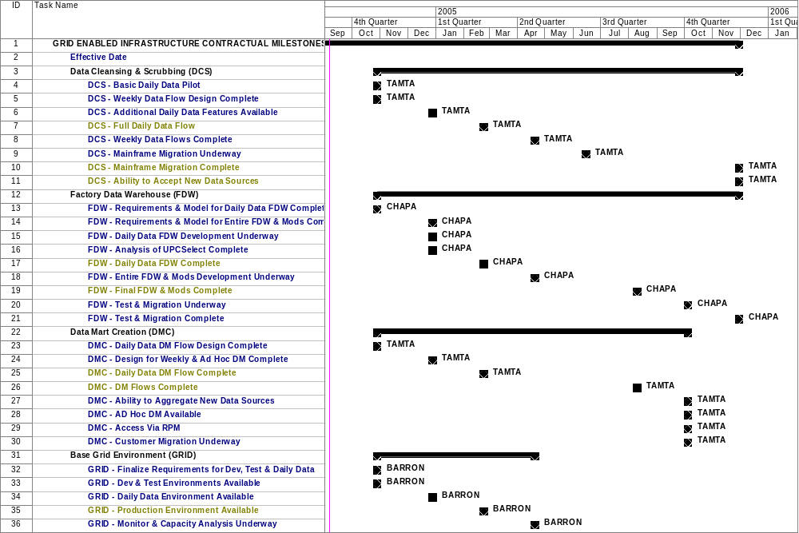
Planned Approach: Contractual Milestones
CODF Transformation Kick-off

Slide 13
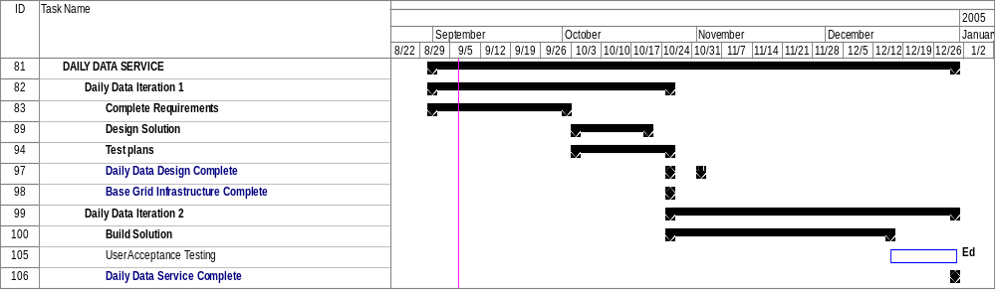
Planned Approach: Daily Data Service
CODF Transformation Kick-off

Slide 14
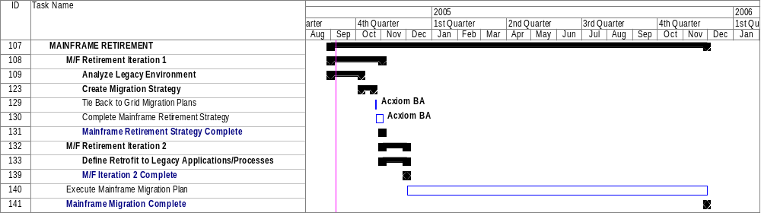
Planned Approach: Mainframe Retirement
CODF Transformation Kick-off

Slide 15
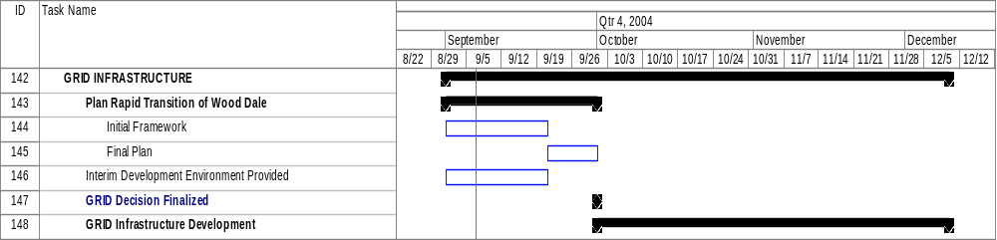
Planned Approach: Grid Infrastructure
CODF Transformation Kick-off

Slide 16
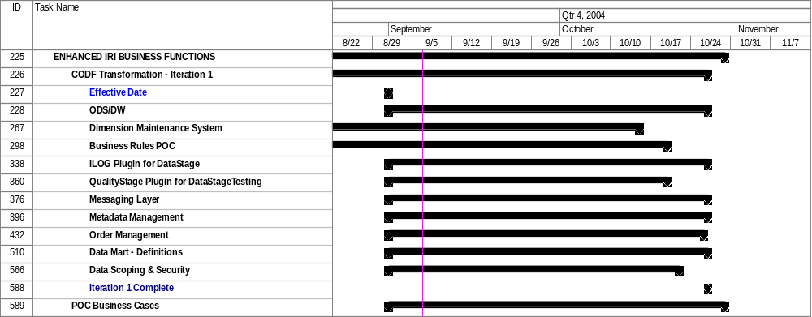
Planned Approach: Enhanced Business Functions
CODF Transformation Kick-off

Slide 17
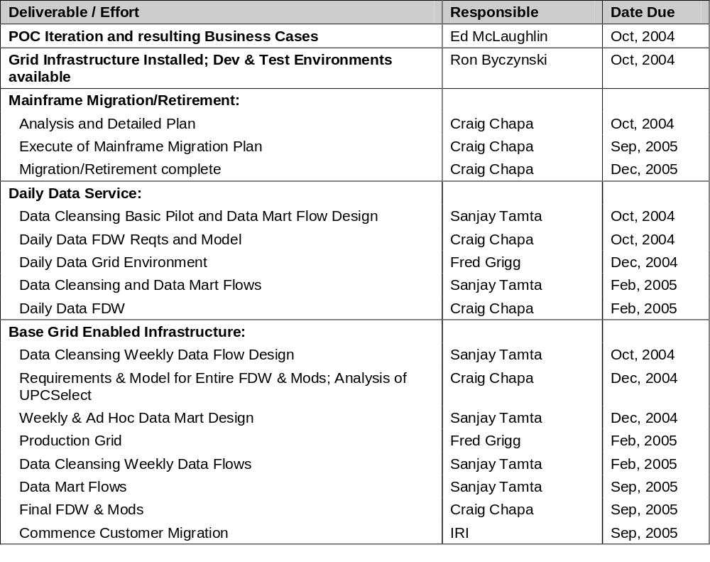
Key Deliverables & Accountabilities
CODF Transformation Kick-off

Slide 18
Key Communications/Controls
CODF Transformation Kick-off
Core Team Leads [twice weekly]
Architect Review [weekly]
Project Status Report [weekly]
Project Oversight Committee [bi-Weekly]
Business / Technical Share [monthly]
SharePoint for:
  Contact information
  Project documentation
  Issues management
  Risk management
  Change management

Slide 19
Collaboration Tool
CODF Transformation Kick-off
Demo of SharePoint tool:
https://iriteams.infores.com/sites/regfactory/default.aspx

Slide 20
Logistics
CODF Transformation Kick-off
Current space issues:
  Limited
  Cramped
Exploring a number of options to collocate whole CODF Transformation team here at IRI offices
Non-IRI resources need to be added to Active Directory to provide SharePoint, VPN and Internet access:
  Name
  Email address

Slide 21
Next Steps
CODF Transformation Kick-off
Resources
  Establish and resource Project Office
  Establish and resource cross-functional project teams
  Establish product management & business development teams
  Secure required business SMEs
Process
  Roles, responsibilities and accountabilities defined and agreed
  Formal integrated team kick-offs
  Facilities and communication mechanisms established
  Schedule relevant IRI/Acxiom training
Products
  Requirements definition continue as defined by Iteration Roadmap
  Align Daily Data commitments to CODF plan
  Further advance the business migration plan
Development
  Complete Data Mart model
  Establish GRID development environment
  Execute Iteration 1 of the CODF plan

Slide 22
Questions?
CODF Transformation Kick-off

